Slide 1
Introduction to Machine Learning – Linear Regression Part 2
Dr. Ab Mosca (they/them)
Slides based off slides courtesy of Jordan Crouser (https://jcrouser.github.io/)

Slide 2
Plan for Today
More considerations for regression modeling
Qualitative predictors
Extensions of linear model
Potential problems

Slide 3
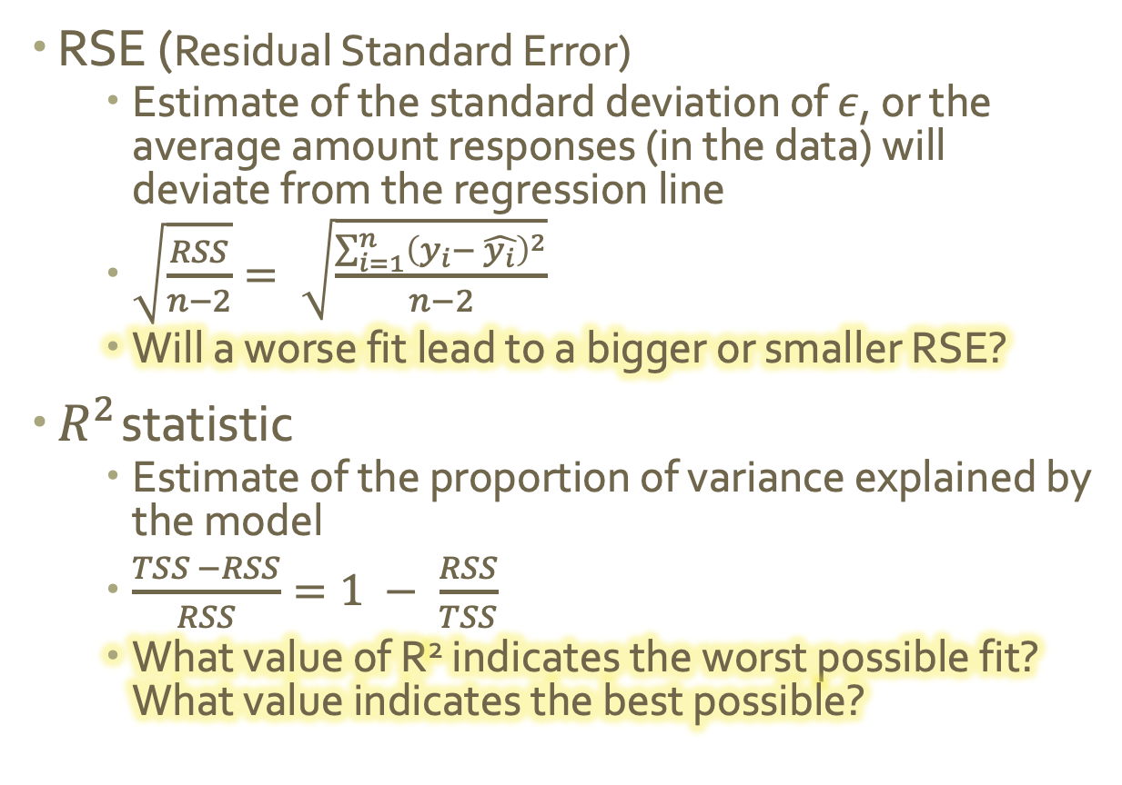
Warm Up
RSE (Residual Standard Error)
Estimate of the standard deviation of $ε$, or the average amount responses (in the data) will deviate from the regression line
$\sqrt{\frac{RSS}{n−2}}= \sqrt{\frac{\sum_{i=1}^{n}{{\left(y_{i}− \hat{y_{i}}\right)}^{2}}}{n−2}}$
Will a worse fit lead to a bigger or smaller RSE?
$R^{2}$ statistic
Estimate of the proportion of variance explained by the model
$\frac{TSS −RSS}{RSS}=1 − \frac{RSS}{TSS}$
What value of R² indicates the worst possible fit? What value indicates the best possible?
Notes:
Worse fit == RSS is bigger, so bigger RSE; no number of RSE means a “good fit” just tells you how bad the fit is
1 = best fit (regression explains a large proportion of variance in Y), 0 = worst fit (regression explains a small proportion of variance in Y)

Slide 4
Qualitative Predictors

Slide 5
Motivation
So far, we have assumed all variables in our linear regression models are quantitative.
Let’s look at a new dataset.

Slide 6
Motivation
Carseats dataset:
Description: simulated data set on sales of car seats
Format: 400 observations on the following 11 variables
Sales: unit sales at each location
CompPrice: price charged by nearest competitor at each location
Income: community income level
Advertising: local advertising budget for company at each location
Population: population size in region (in thousands)
Price: price charged for car seat at each site
ShelveLoc: quality of shelving location at site (Good | Bad | Medium)
Age: average age of the local population
Education: education level at each location
Urban: whether the store is in an urban or rural location
USA: whether the store is in the US or not

Slide 7
Motivation
Carseats dataset:
Description: simulated data set on sales of car seats
Format: 400 observations on the following 11 variables
Sales: unit sales at each location
CompPrice: price charged by nearest competitor at each location
Income: community income level
Advertising: local advertising budget for company at each location
Population: population size in region (in thousands)
Price: price charged for car seat at each site
ShelveLoc: quality of shelving location at site (Good | Bad | Medium)
Age: average age of the local population
Education: education level at each location
Urban: whether the store is in an urban or rural location
USA: whether the store is in the US or not
What if I want to use Urban to predict Sales?

Slide 8
Motivation
Carseats dataset:
Description: simulated data set on sales of car seats
Format: 400 observations on the following 11 variables
Sales: unit sales at each location
CompPrice: price charged by nearest competitor at each location
Income: community income level
Advertising: local advertising budget for company at each location
Population: population size in region (in thousands)
Price: price charged for car seat at each site
ShelveLoc: quality of shelving location at site (Good | Bad | Medium)
Age: average age of the local population
Education: education level at each location
Urban: whether the store is in an urban or rural location
USA: whether the store is in the US or not
What if I want to use Urban to predict Sales?
Can we do this with our current methods? Why or why not?

Slide 9
Motivation
So far, we have assumed all variables in our linear regression models are quantitative.
Sometimes, our predictors are qualitative.
Ex.
Urban: whether the store is in an urban or rural location

Slide 10
Two Levels
So far, we have assumed all variables in our linear regression models are quantitative.
Sometimes, our predictors are qualitative.
Ex.
Urban: whether the store is in an urban or rural location
Notice Urban only has 2 levels – urban or rural
To incorporate it into a regression, we create a dummy variable.

Slide 11
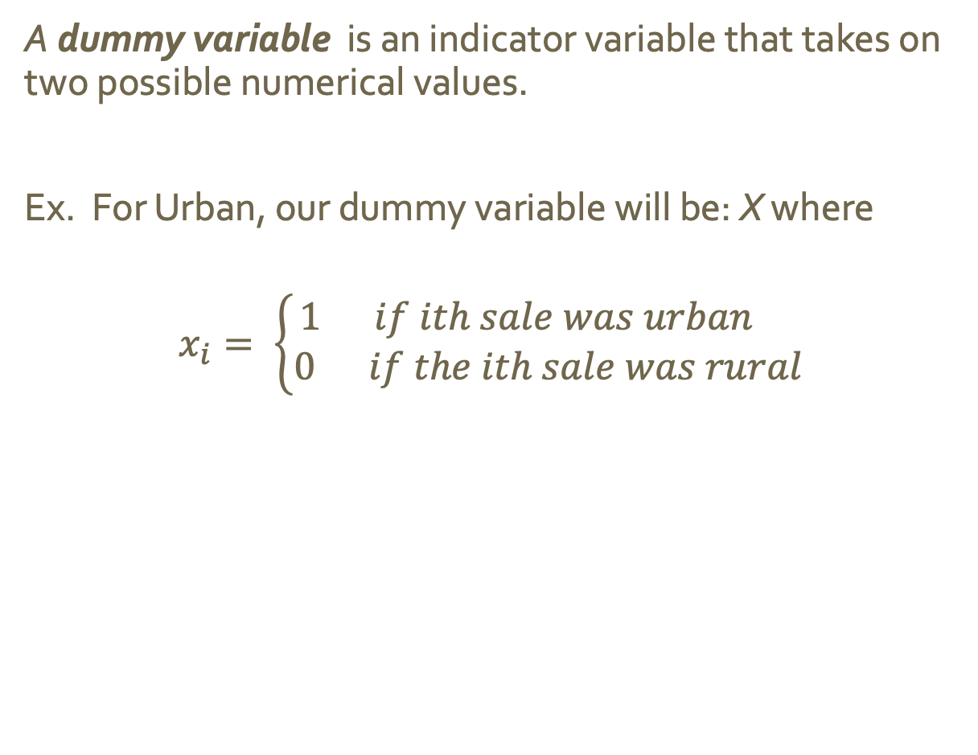
Two Levels
A dummy variable is an indicator variable that takes on two possible numerical values.
Ex. For Urban, our dummy variable will be: X where
$$x_{i}= \left\{\begin{aligned}1 if ith sale was urban \\ 0 if the ith sale was rural \end{aligned}\right.$$

Slide 12
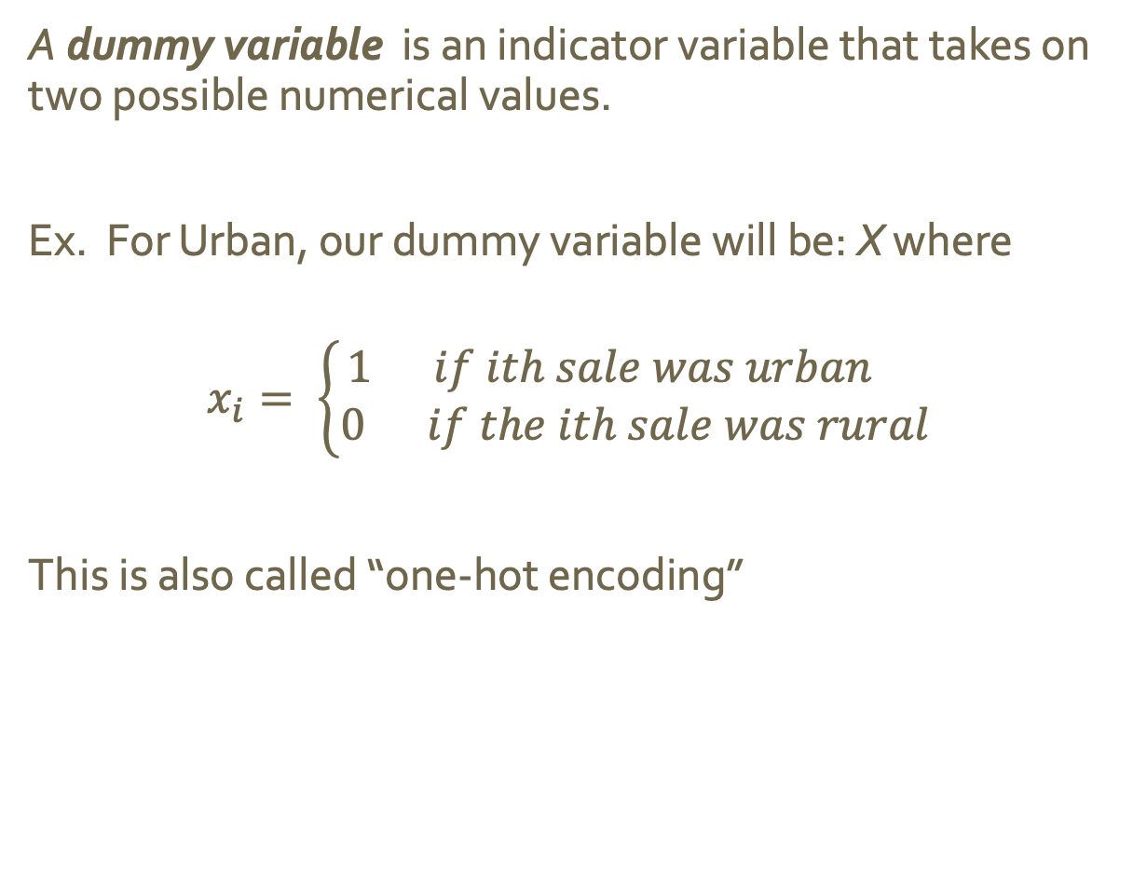
Two Levels
A dummy variable is an indicator variable that takes on two possible numerical values.
Ex. For Urban, our dummy variable will be: X where
$$x_{i}= \left\{\begin{aligned}1 if ith sale was urban \\ 0 if the ith sale was rural \end{aligned}\right.$$
This is also called “one-hot encoding”

Slide 13
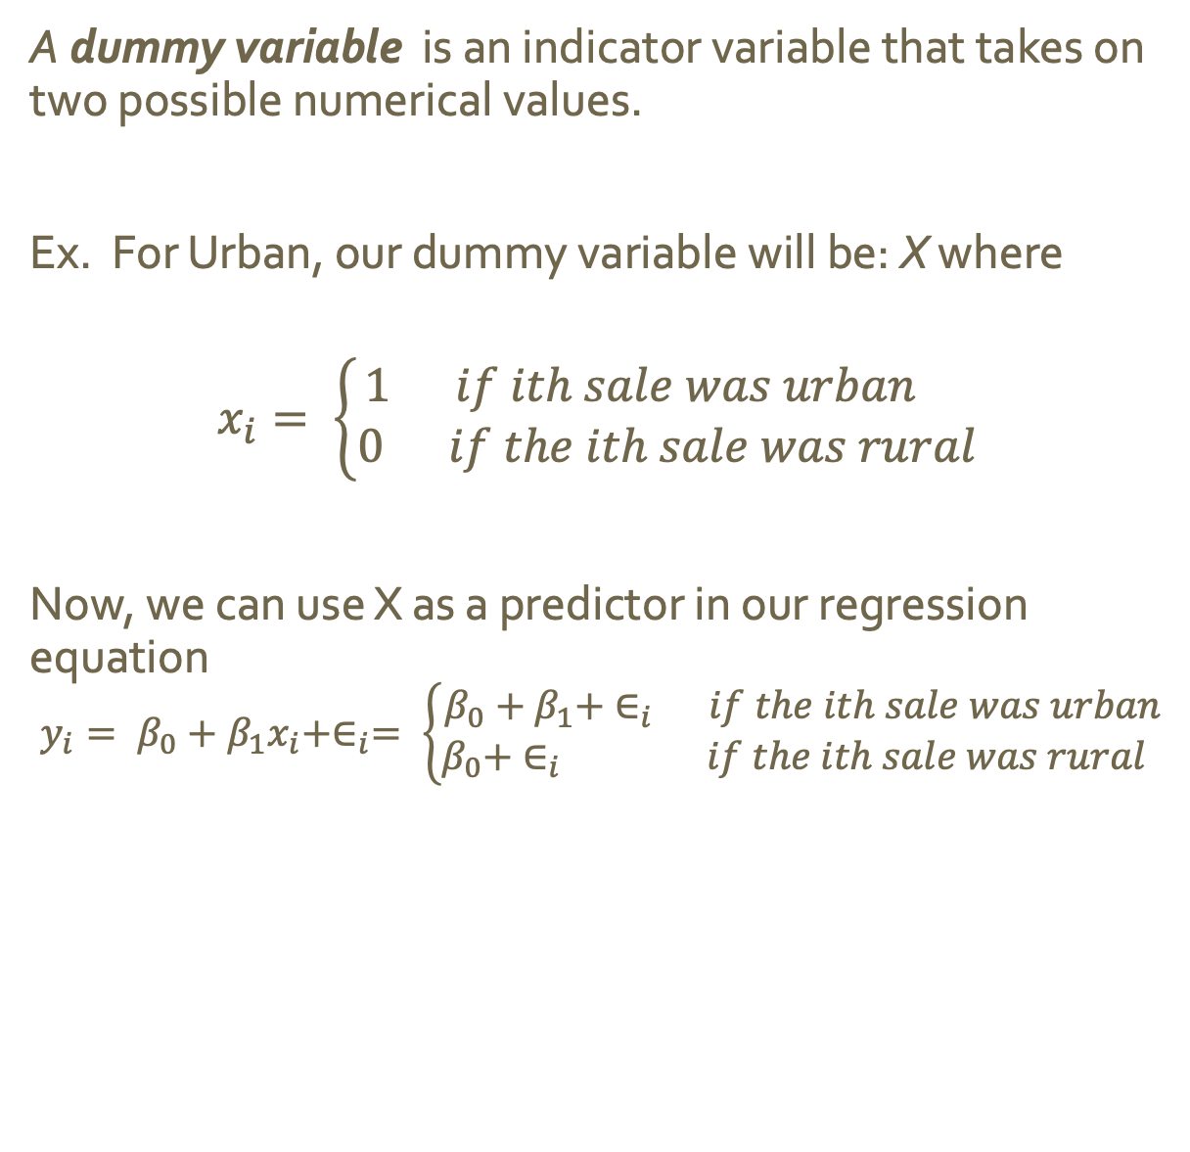
Two Levels
A dummy variable is an indicator variable that takes on two possible numerical values.
Ex. For Urban, our dummy variable will be: X where
$$x_{i}= \left\{\begin{aligned}1 if ith sale was urban \\ 0 if the ith sale was rural \end{aligned}\right.$$
Now, we can use X as a predictor in our regression equation
$$y_{i}= β_{0}+β_{1}x_{i}+∈_{i}= \left\{\begin{aligned}β_{0}+β_{1}+ ∈_{i} if the ith sale was urban \\ β_{0}+ ∈_{i} if the ith sale was rural \end{aligned}\right.$$

Slide 14
Two Levels
A dummy variable is an indicator variable that takes on two possible numerical values.
Ex. For Urban, our dummy variable will be: X where
$$x_{i}= \left\{\begin{aligned}1 if ith sale was urban \\ 0 if the ith sale was rural \end{aligned}\right.$$
Now, we can use X as a predictor in our regression equation
$$y_{i}= β_{0}+β_{1}x_{i}+∈_{i}= \left\{\begin{aligned}β_{0}+β_{1}+ ∈_{i} if the ith sale was urban \\ β_{0}+ ∈_{i} if the ith sale was rural \end{aligned}\right.$$
What does $β_{0}$ represent in the context of this problem? What does $β_{1}$ represent in the context of this problem?
Notes:
B_0 is average sale if sale was rural
B_1 average difference between urban and rural sales

Slide 15
Two Levels
A dummy variable is an indicator variable that takes on two possible numerical values.
Ex. For Urban, our dummy variable will be: X where
$$x_{i}= \left\{\begin{aligned}1 if ith sale was urban \\ 0 if the ith sale was rural \end{aligned}\right.$$
Now, we can use X as a predictor in our regression equation
$$y_{i}= β_{0}+β_{1}x_{i}+∈_{i}= \left\{\begin{aligned}β_{0}+β_{1}+ ∈_{i} if the ith sale was urban \\ β_{0}+ ∈_{i} if the ith sale was rural \end{aligned}\right.$$
What happens if I code the dummy variable 0/1 instead of 1/0? What if I code it 1/-1?
Notes:
For opposite:
B_0 is average sale if sale was urban
B_1 average difference between urban and rural sales
For 1/-1:
B_0 overall average credit card balance
B_1 average difference from mean for urban vs rural

Slide 16
More than Two Levels
If a qualitative predictor has more than 2 levels, we can’t use a single dummy variable to represent all possible values. But we can use multiple dummy variables.

Slide 17
More than Two Levels
If a qualitative predictor has more than 2 levels, we can’t use a single dummy variable to represent all possible values. But we can use multiple dummy variables.
Ex. Let’s say we want to use ShelveLoc (quality of shelving location at site <Good | Bad | Medium>) to predict Sales

Slide 18
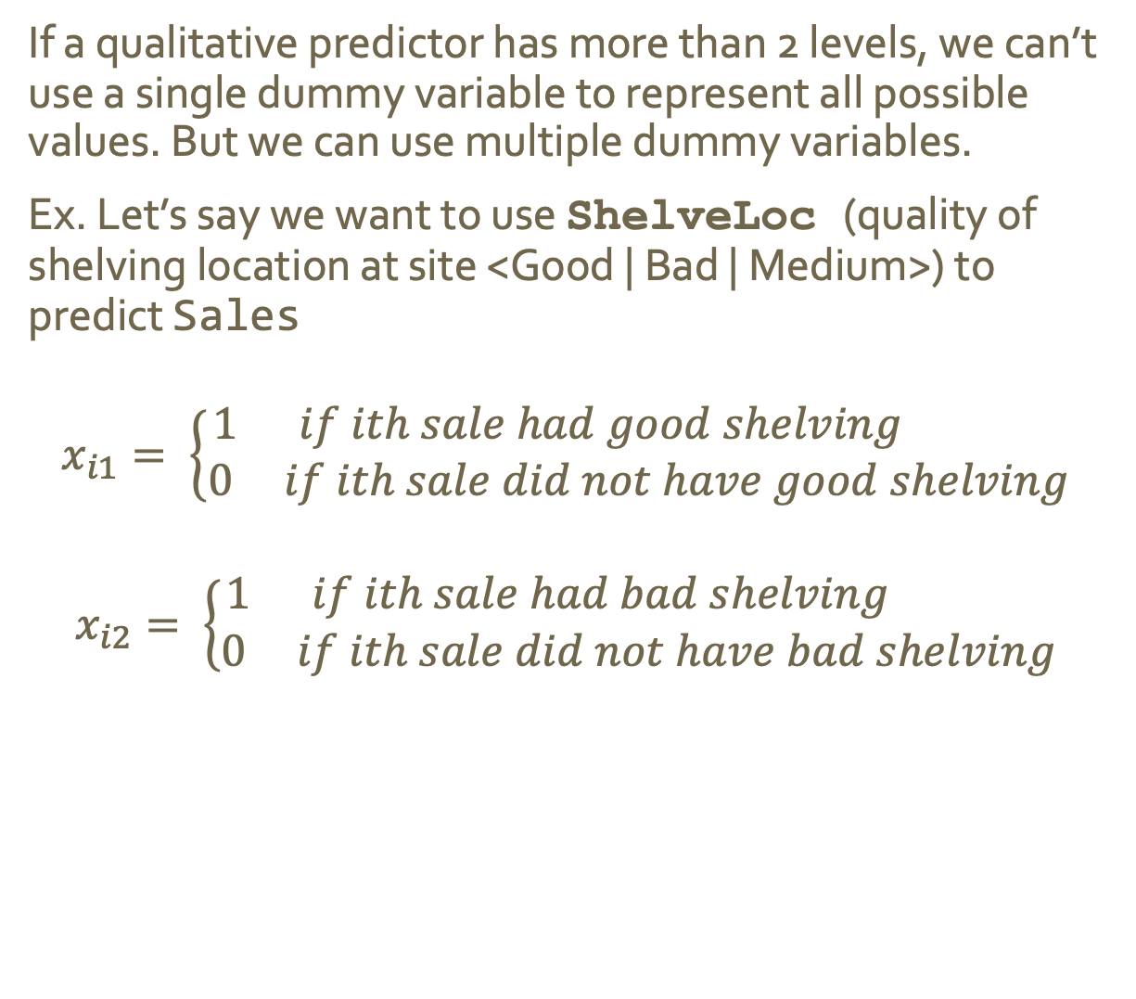
More than Two Levels
If a qualitative predictor has more than 2 levels, we can’t use a single dummy variable to represent all possible values. But we can use multiple dummy variables.
Ex. Let’s say we want to use ShelveLoc (quality of shelving location at site <Good | Bad | Medium>) to predict Sales
$$x_{i1}= \left\{\begin{aligned}1 if ith sale had good shelving \\ 0 if ith sale did not have good shelving\end{aligned} \right.$$
$$x_{i2}= \left\{\begin{aligned}1 if ith sale had bad shelving \\ 0 if ith sale did not have bad shelving\end{aligned} \right.$$

Slide 19
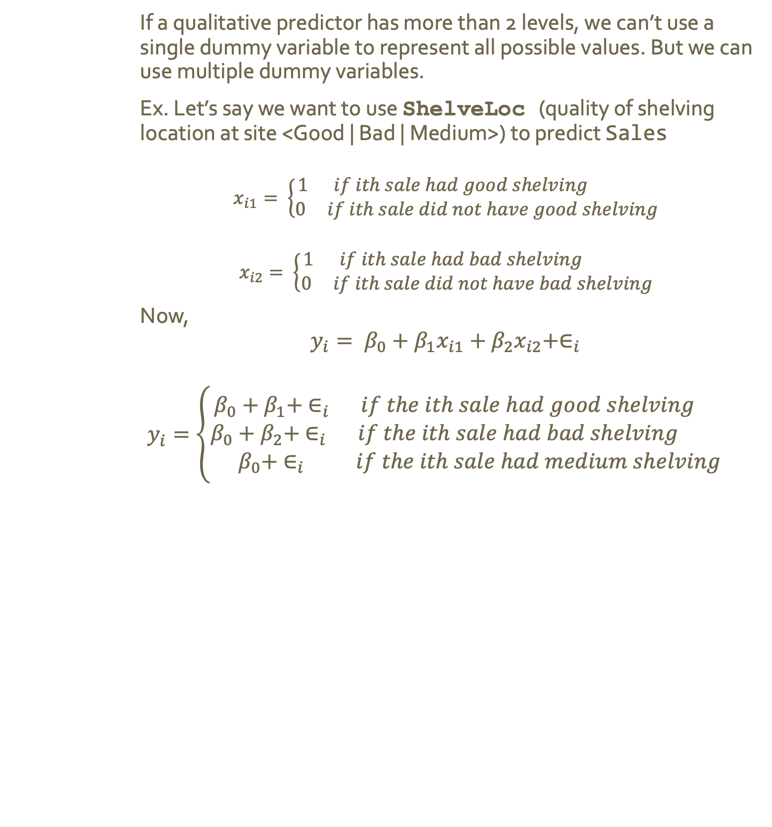
More than Two Levels
If a qualitative predictor has more than 2 levels, we can’t use a single dummy variable to represent all possible values. But we can use multiple dummy variables.
Ex. Let’s say we want to use ShelveLoc (quality of shelving location at site <Good | Bad | Medium>) to predict Sales
$$x_{i1}= \left\{\begin{aligned}1 if ith sale had good shelving \\ 0 if ith sale did not have good shelving\end{aligned} \right.$$
$$x_{i2}= \left\{\begin{aligned}1 if ith sale had bad shelving \\ 0 if ith sale did not have bad shelving\end{aligned} \right.$$
Now,
$$y_{i}= β_{0}+β_{1}x_{i1}+β_{2}x_{i2}+∈_{i}$$
$$y_{i}=\left\{\begin{aligned}β_{0}+β_{1}+ ∈_{i} if the ith sale had good shelving \\ β_{0}+β_{2}+ ∈_{i} if the ith sale had bad shelving \\ β_{0}+ ∈_{i} if the ith sale had medium shelving\end{aligned}\right.$$

Slide 20
More than Two Levels
What does each coefficient represent?
If a qualitative predictor has more than 2 levels, we can’t use a single dummy variable to represent all possible values. But we can use multiple dummy variables.
Ex. Let’s say we want to use ShelveLoc (quality of shelving location at site <Good | Bad | Medium>) to predict Sales
$$x_{i1}= \left\{\begin{aligned}1 if ith sale had good shelving \\ 0 if ith sale did not have good shelving\end{aligned} \right.$$
$$x_{i2}= \left\{\begin{aligned}1 if ith sale had bad shelving \\ 0 if ith sale did not have bad shelving\end{aligned} \right.$$
Now,
$$y_{i}= β_{0}+β_{1}x_{i1}+β_{2}x_{i2}+∈_{i}$$
$$y_{i}=\left\{\begin{aligned}β_{0}+β_{1}+ ∈_{i} if the ith sale had good shelving \\ β_{0}+β_{2}+ ∈_{i} if the ith sale had bad shelving \\ β_{0}+ ∈_{i} if the ith sale had medium shelving\end{aligned}\right.$$

Slide 21
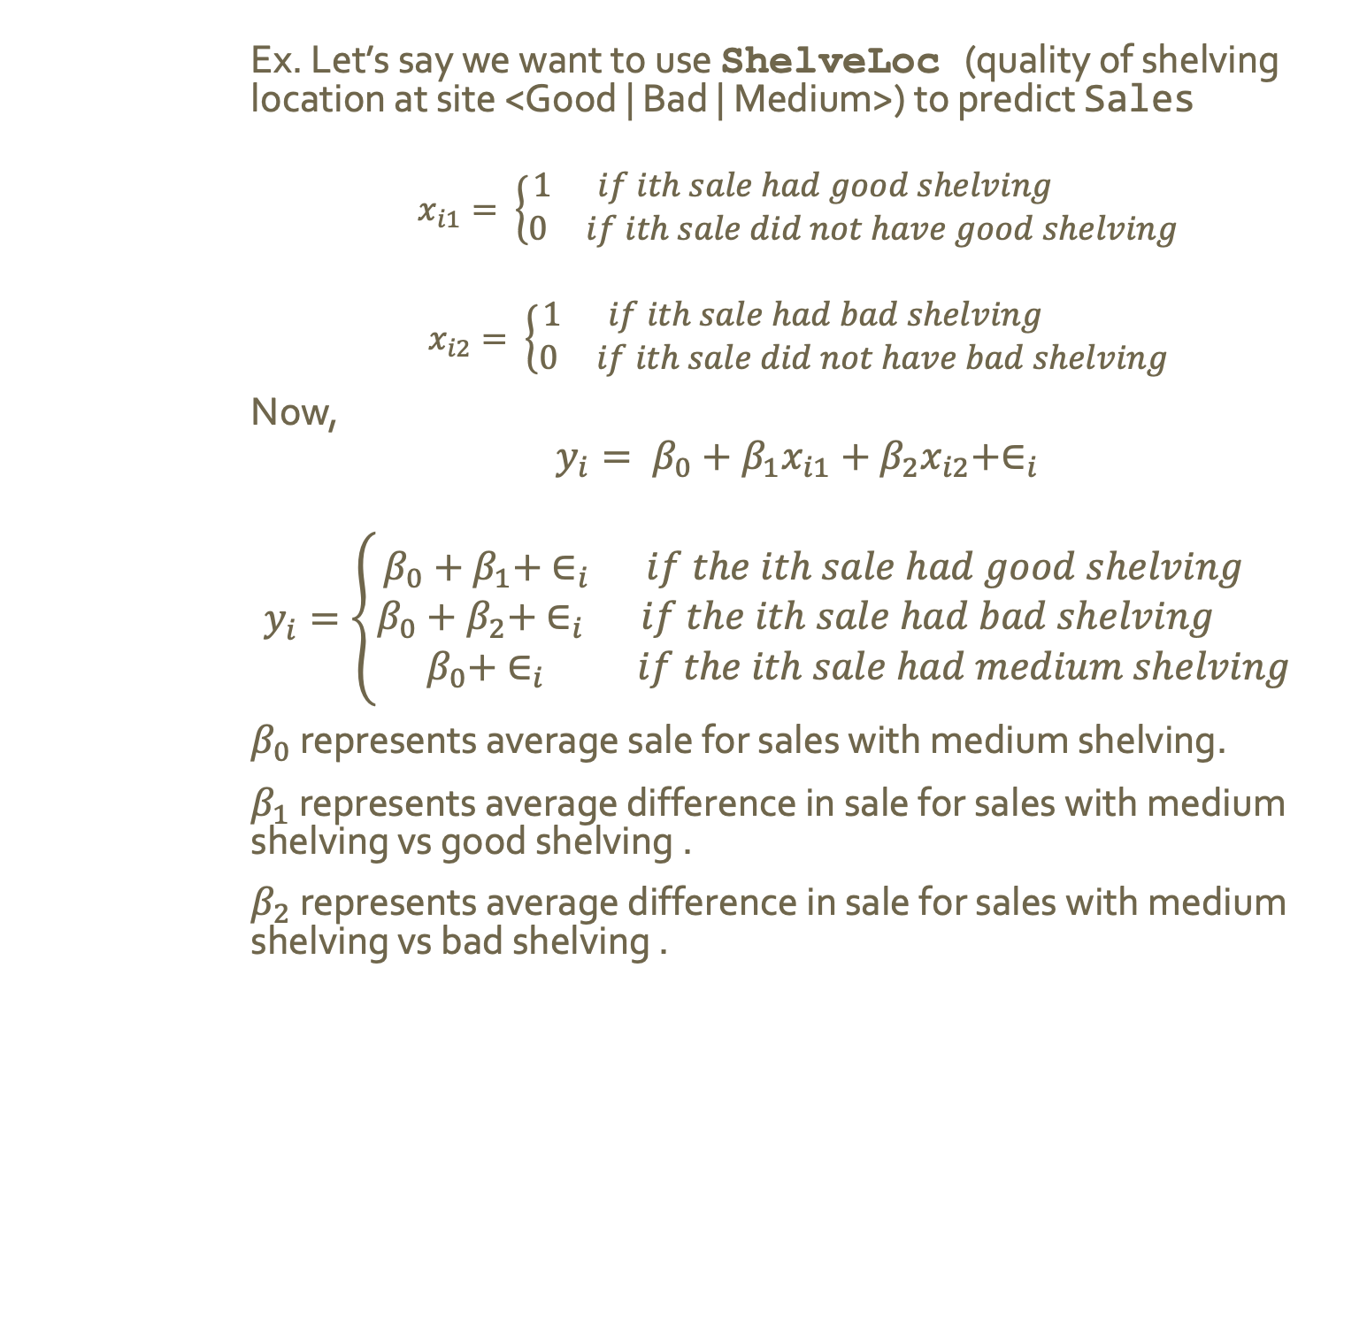
More than Two Levels
Ex. Let’s say we want to use ShelveLoc (quality of shelving location at site <Good | Bad | Medium>) to predict Sales
$$x_{i1}= \left\{\begin{aligned}1 if ith sale had good shelving \\ 0 if ith sale did not have good shelving\end{aligned} \right.$$
$$x_{i2}= \left\{\begin{aligned}1 if ith sale had bad shelving \\ 0 if ith sale did not have bad shelving\end{aligned} \right.$$
Now,
$$y_{i}= β_{0}+β_{1}x_{i1}+β_{2}x_{i2}+∈_{i}$$
$$y_{i}=\left\{\begin{aligned}β_{0}+β_{1}+ ∈_{i} if the ith sale had good shelving \\ β_{0}+β_{2}+ ∈_{i} if the ith sale had bad shelving \\ β_{0}+ ∈_{i} if the ith sale had medium shelving\end{aligned}\right.$$
$β_{0}$ represents average sale for sales with medium shelving.
$β_{1}$ represents average difference in sale for sales with medium shelving vs good shelving .
$β_{2}$ represents average difference in sale for sales with medium shelving vs bad shelving .

Slide 22
More than Two Levels
Ex. Let’s say we want to use ShelveLoc (quality of shelving location at site <Good | Bad | Medium>) to predict Sales
$$x_{i1}= \left\{\begin{aligned}1 if ith sale had good shelving \\ 0 if ith sale did not have good shelving\end{aligned} \right.$$
$$x_{i2}= \left\{\begin{aligned}1 if ith sale had bad shelving \\ 0 if ith sale did not have bad shelving\end{aligned} \right.$$
Now,
$$y_{i}= β_{0}+β_{1}x_{i1}+β_{2}x_{i2}+∈_{i}$$
$$y_{i}=\left\{\begin{aligned}β_{0}+β_{1}+ ∈_{i} if the ith sale had good shelving \\ β_{0}+β_{2}+ ∈_{i} if the ith sale had bad shelving \\ β_{0}+ ∈_{i} if the ith sale had medium shelving\end{aligned}\right.$$
$β_{0}$ represents average sale for sales with medium shelving.
$β_{1}$ represents average difference in sale for sales with medium shelving vs good shelving .
$β_{2}$ represents average difference in sale for sales with medium shelving vs bad shelving .
Notice we have 1 fewer dummy variables than levels.
The level with no dummy variable is known as the baseline.

Slide 23
Extensions of Linear Models

Slide 24
Assumptions
Standard linear regression is great for interpretable results, and works well on many real-world scenarios.
But it makes several assumptions that are often violated in practice.
Two important one are that the relationship between the predictors and response are
Additive
and
Linear

Slide 25
Additive Assumption
The additive assumption states that the association between a predictor, X_{j} , and the response Y does not depend on the values of the other predictors.

Slide 26
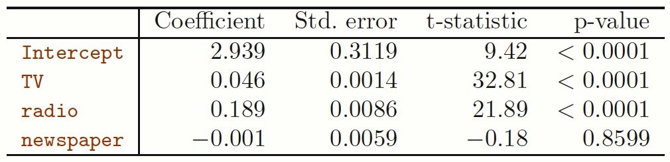
Additive Assumption
The additive assumption states that the association between a predictor, X_{j} , and the response Y does not depend on the values of the other predictors.
Remember our Advertising model
Notes:
This model assumes average increase in sales associated with a 1 unit increate in tv is always B_1, regardless of the amount spent on radio.

Slide 27



Additive Assumption
The additive assumption states that the association between a predictor, X_{j} , and the response Y does not depend on the values of the other predictors.
Remember our Advertising model
Notes:
However, this may be incorrect.
Suppose spending money on radio advertising actually increases effectiveness of tv adds
then, the slope term for TV should increase as radio increase
This is called synergy in advertising, and an interaction effect in ML

Slide 28
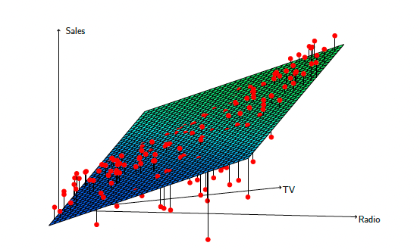
Interaction Effects

Slide 29
Interaction Effects
Spend a lot on
either TV OR Radio =
model overestimates
Notes:
Spend a lot on TV or Radio, model overestimates

Slide 30
Interaction Effects
Balanced spending
Between TV and Radio =
model underestimates
Notes:
Balances spending model underestimates

Slide 31
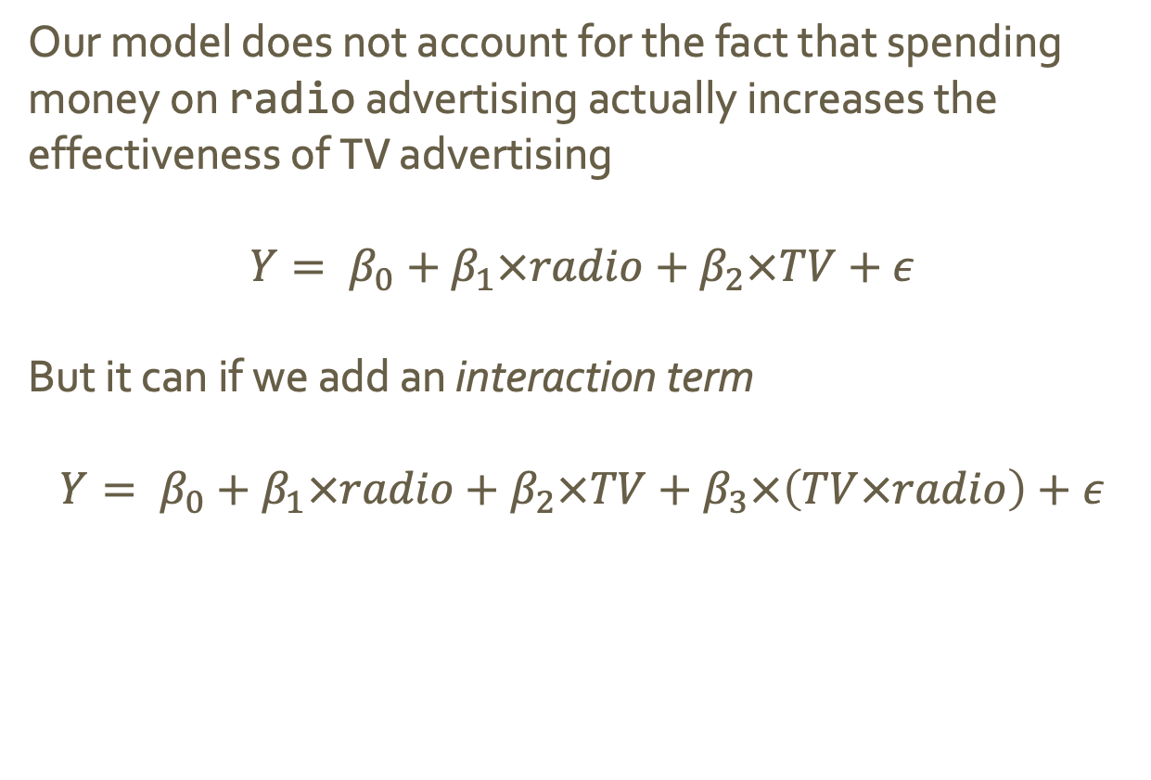
Interaction Effects
Our model does not account for the fact that spending money on radio advertising actually increases the effectiveness of TV advertising
$$Y= β_{0}+β_{1}×radio+β_{2}×TV+ε$$
But it can if we add an interaction term
$$Y= β_{0}+β_{1}×radio+β_{2}×TV+β_{3}×\left(TV×radio\right)+ε$$
Notes:
Balances spending model underestimates

Slide 32
Interaction Effects
Our model does not account for the fact that spending money on radio advertising actually increases the effectiveness of TV advertising
$$Y= β_{0}+β_{1}×radio+β_{2}×TV+ε$$
But it can if we add an interaction term
$$Y= β_{0}+β_{1}×radio+β_{2}×TV+β_{3}×\left(TV×radio\right)+ε$$
How does this fix the problem?
Hint: What is the new slope for radio?

Slide 33
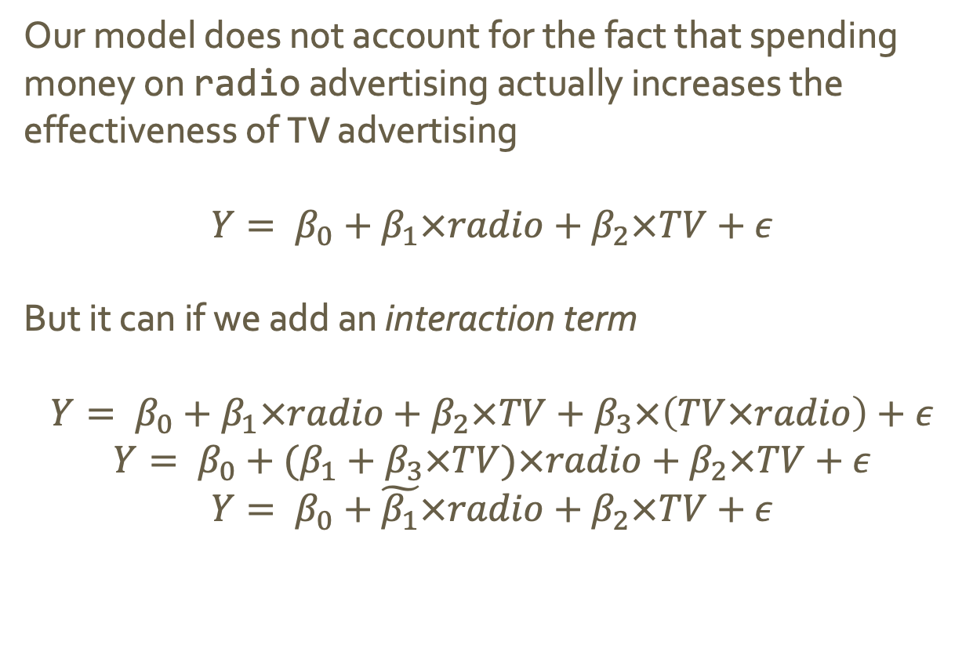
Interaction Effects
Our model does not account for the fact that spending money on radio advertising actually increases the effectiveness of TV advertising
$$Y= β_{0}+β_{1}×radio+β_{2}×TV+ε$$
But it can if we add an interaction term
$$Y= β_{0}+β_{1}×radio+β_{2}×TV+β_{3}×\left(TV×radio\right)+ε$$
$$Y= β_{0}+(β_{1}+β_{3}×TV)×radio+β_{2}×TV+ε$$
$$Y= β_{0}+\tilde{β_{1}}×radio+β_{2}×TV+ε$$
Notes:
We can interpret B_3 as the increase in effectiveness of TV advertising associated with a one-unit increase in radio advertising (or vice versa)

Slide 34
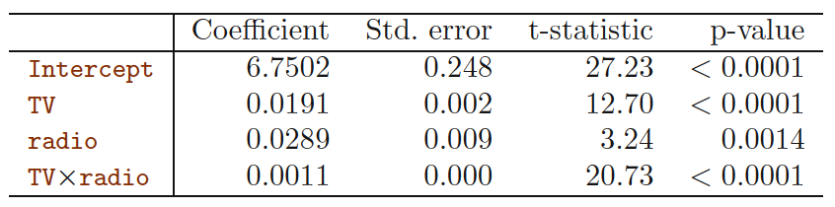
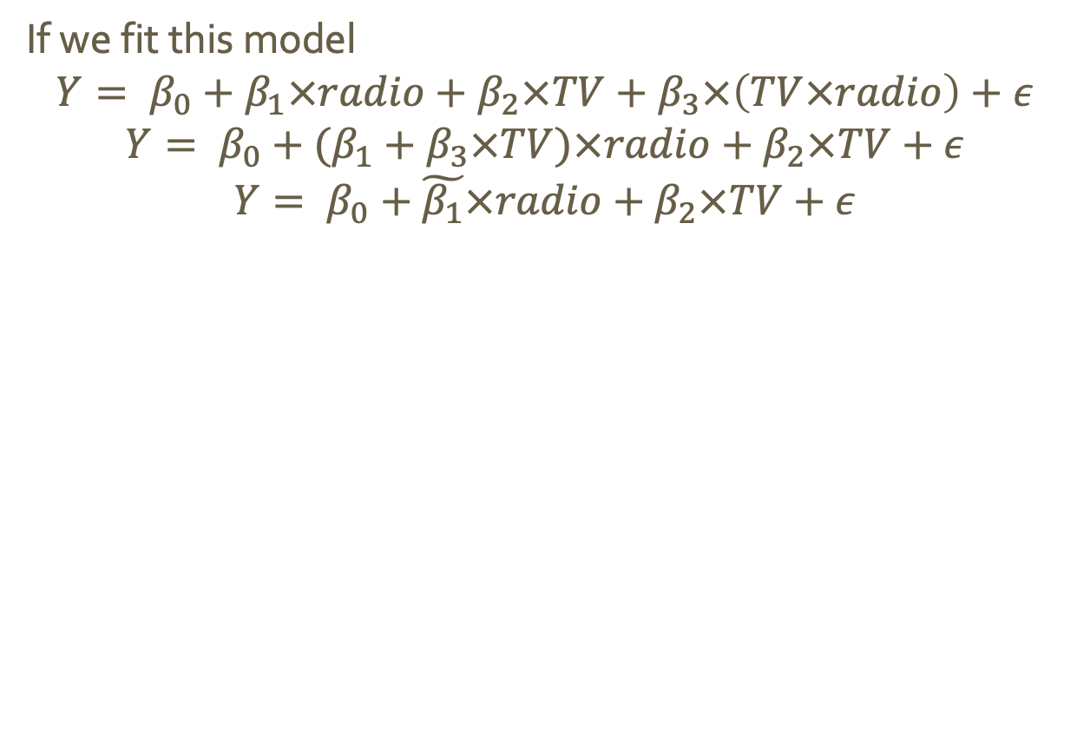
Interaction Effects
If we fit this model
$$Y= β_{0}+β_{1}×radio+β_{2}×TV+β_{3}×\left(TV×radio\right)+ε$$
$$Y= β_{0}+(β_{1}+β_{3}×TV)×radio+β_{2}×TV+ε$$
$$Y= β_{0}+\tilde{β_{1}}×radio+β_{2}×TV+ε$$
Notes:
We can

Slide 35
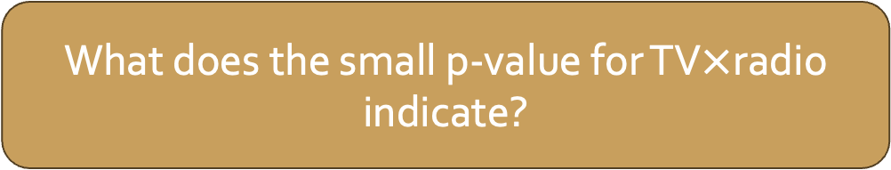
Interaction Effects
If we fit this model
$$Y= β_{0}+β_{1}×radio+β_{2}×TV+β_{3}×\left(TV×radio\right)+ε$$
$$Y= β_{0}+(β_{1}+β_{3}×TV)×radio+β_{2}×TV+ε$$
$$Y= β_{0}+\tilde{β_{1}}×radio+β_{2}×TV+ε$$
What does the small p-value for TV$×$radio indicate?
Notes:
We can

Slide 36
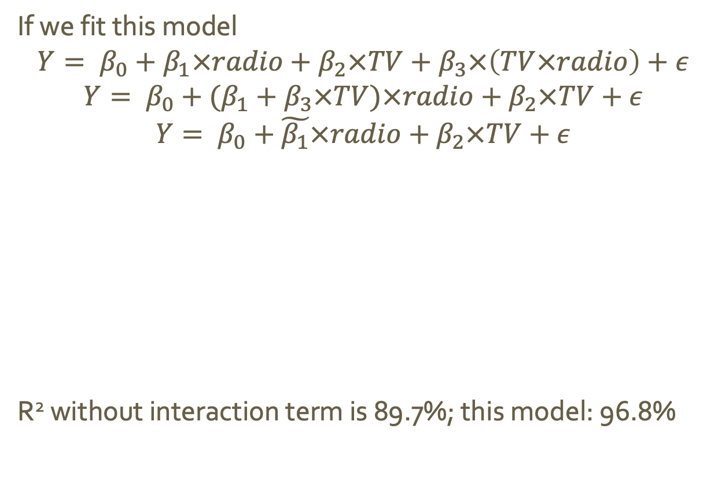
Interaction Effects
If we fit this model
$$Y= β_{0}+β_{1}×radio+β_{2}×TV+β_{3}×\left(TV×radio\right)+ε$$
$$Y= β_{0}+(β_{1}+β_{3}×TV)×radio+β_{2}×TV+ε$$
$$Y= β_{0}+\tilde{β_{1}}×radio+β_{2}×TV+ε$$
R² without interaction term is 89.7%; this model: 96.8%
Notes:
We can

Slide 37
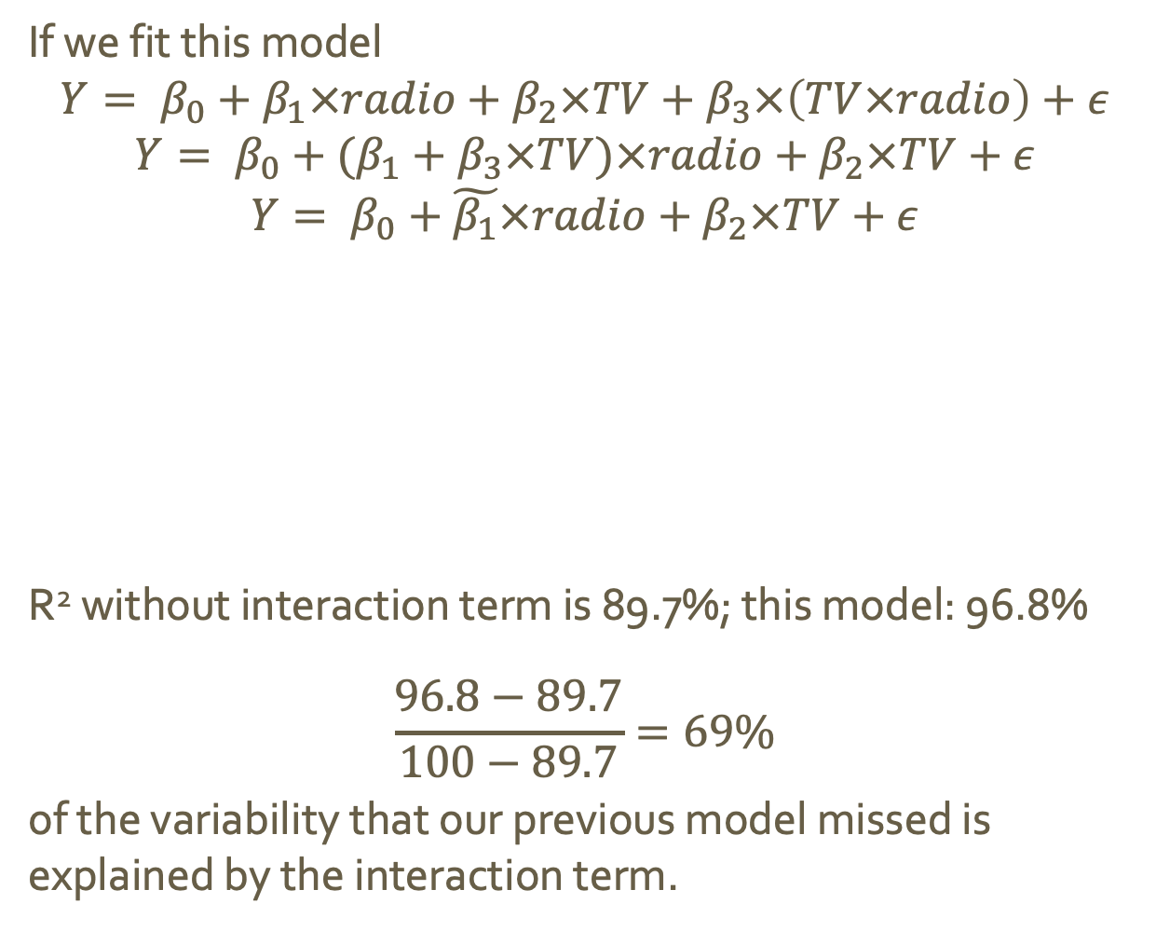
Interaction Effects
If we fit this model
$$Y= β_{0}+β_{1}×radio+β_{2}×TV+β_{3}×\left(TV×radio\right)+ε$$
$$Y= β_{0}+(β_{1}+β_{3}×TV)×radio+β_{2}×TV+ε$$
$$Y= β_{0}+\tilde{β_{1}}×radio+β_{2}×TV+ε$$
R² without interaction term is 89.7%; this model: 96.8%
$$\frac{96.8−89.7}{100−89.7}=69\%$$
of the variability that our previous model missed is explained by the interaction term.
diff. var. explained
by each model
var. missed
by first model
Notes:
We can

Slide 38
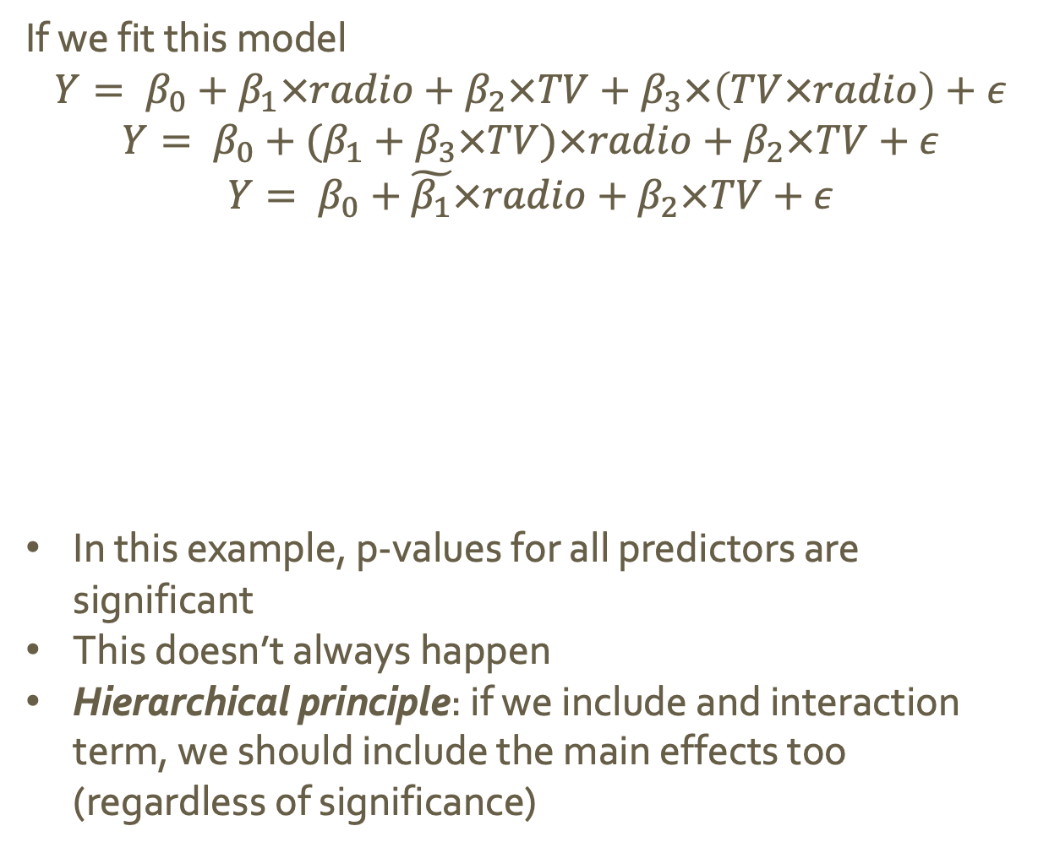
Interaction Effects
If we fit this model
$$Y= β_{0}+β_{1}×radio+β_{2}×TV+β_{3}×\left(TV×radio\right)+ε$$
$$Y= β_{0}+(β_{1}+β_{3}×TV)×radio+β_{2}×TV+ε$$
$$Y= β_{0}+\tilde{β_{1}}×radio+β_{2}×TV+ε$$
In this example, p-values for all predictors are significant
This doesn’t always happen
Hierarchical principle: if we include and interaction term, we should include the main effects too (regardless of significance)
Notes:
We can

Slide 39
Linearity Assumption
The linearity assumption states that the change in the response, Y, associated with a one-unit change in X_{j} is constant, regardless of the value of X_{j}.

Slide 40
Linearity Assumption
The linearity assumption states that the change in the response, Y, associated with a one-unit change in X_{j} is constant, regardless of the value of X_{j}.
If the true relationship is far from linear:
The conclusions we draw from a linear model are probably flawed
The prediction accuracy of the model is likely pretty low

Slide 41
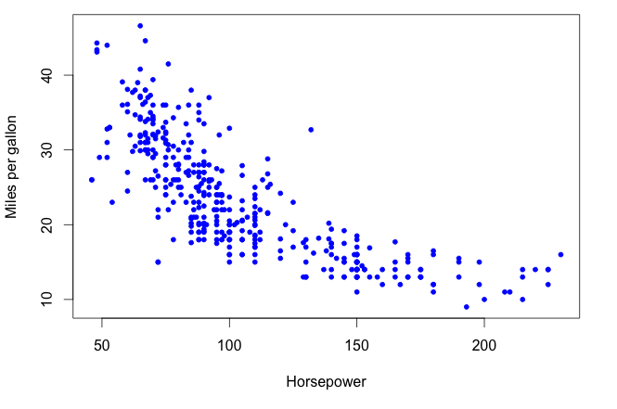
Linearity Assumption
Example:

Slide 42
Linearity Assumption
Example:

Slide 43
Linearity Assumption
Example:

Slide 44
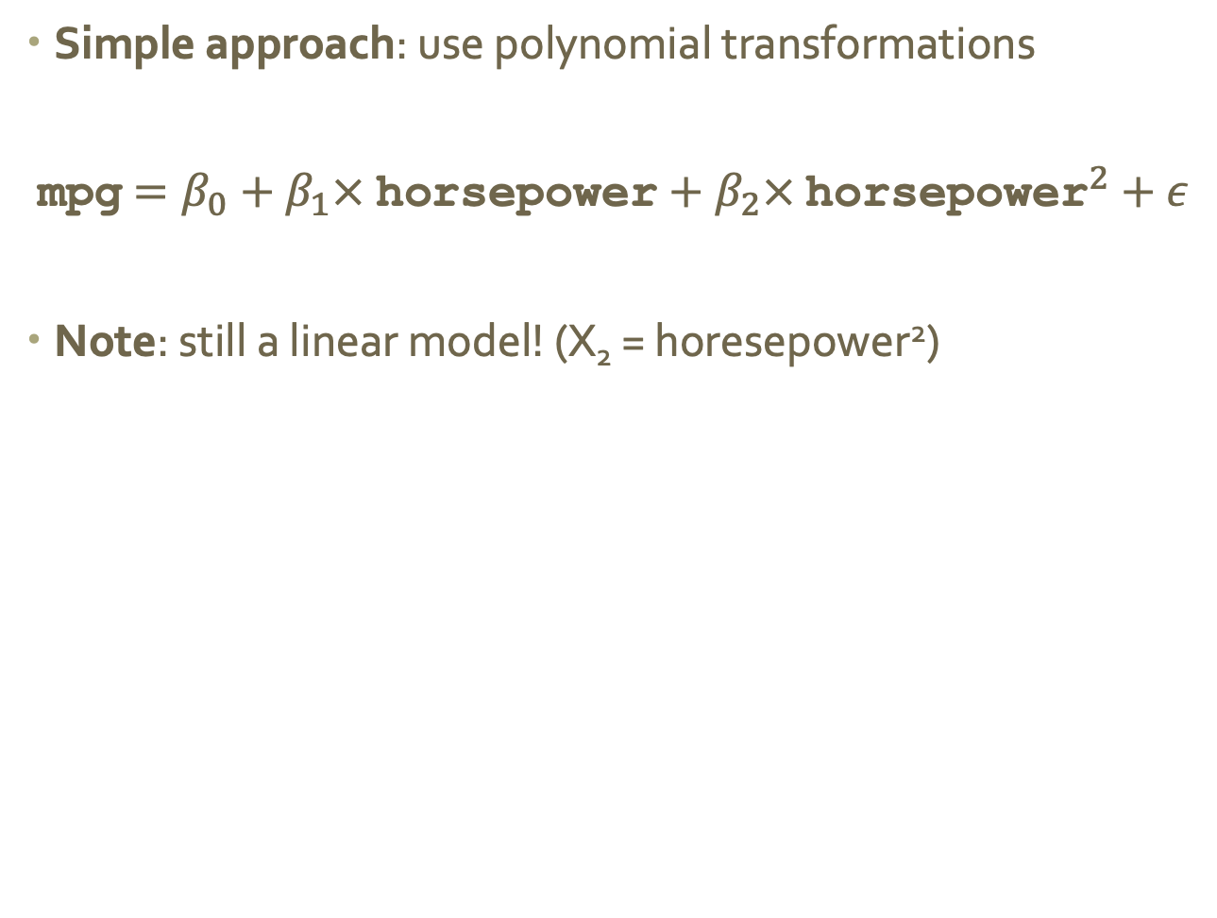
Polynomial Regression
Simple approach: use polynomial transformations
mpg$=β_{0}+β_{1}× \text{horsepower}+β_{2}× {\text{horsepower}}^{2}+ε$
Note: still a linear model! (X₂ = horesepower²)

Slide 45
Polynomial Regression
Simple approach: use polynomial transformations
mpg$=β_{0}+β_{1}× \text{horsepower}+β_{2}× {\text{horsepower}}^{2}+ε$
Note: still a linear model! (X₂ = horesepower²)
How do we know the correct power?!

Slide 46
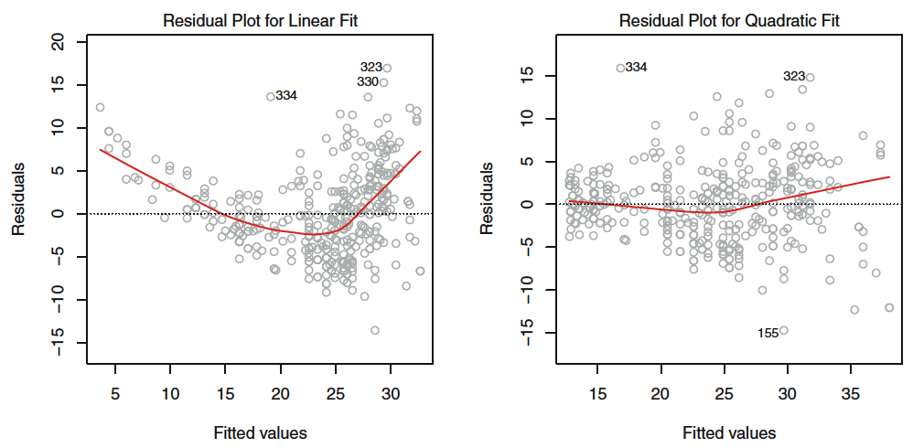
How to tell if you need more power
Residual plots can help identify problem areas in the model by highlighting patterns in errors
Notes:
Left strong pattern in residuals indicates non-linearity in the data
Right there is little pattern in residuals; indicating a better fit

Slide 47
Potential Problems

Slide 48
Breaking Linear Regression
Potential issues
Correlated error terms
Non-constant variance of error terms
Outliers
High leverage points
Collinearity

Slide 49
Correlated Error Terms
LR assumes that the error terms are uncorrelated
If these terms are correlated, the estimated standard error will tend to underestimate the true standard error. As a result,
CI’s will be narrower than they should be and
p-values will be lower than they should be
Notes:
Cis are lower bc SE is lower than it should be
p-values are lower bc

Slide 50
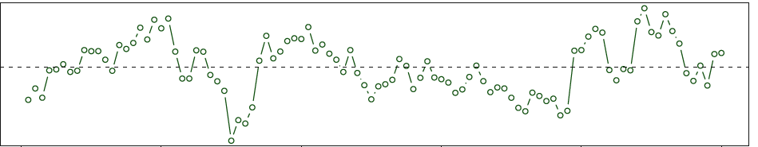
Correlated Error Terms
Checking for correlated error terms in time-series data
Plot residuals as a function of time
If error are uncorrelated, there will be no discernable pattern
If errors are correlated, we will see tracking (adjacent residuals with similar values)
“tracking”
Notes:
Cis are lower bc SE is lower than it should be
p-values are lower bc

Slide 51
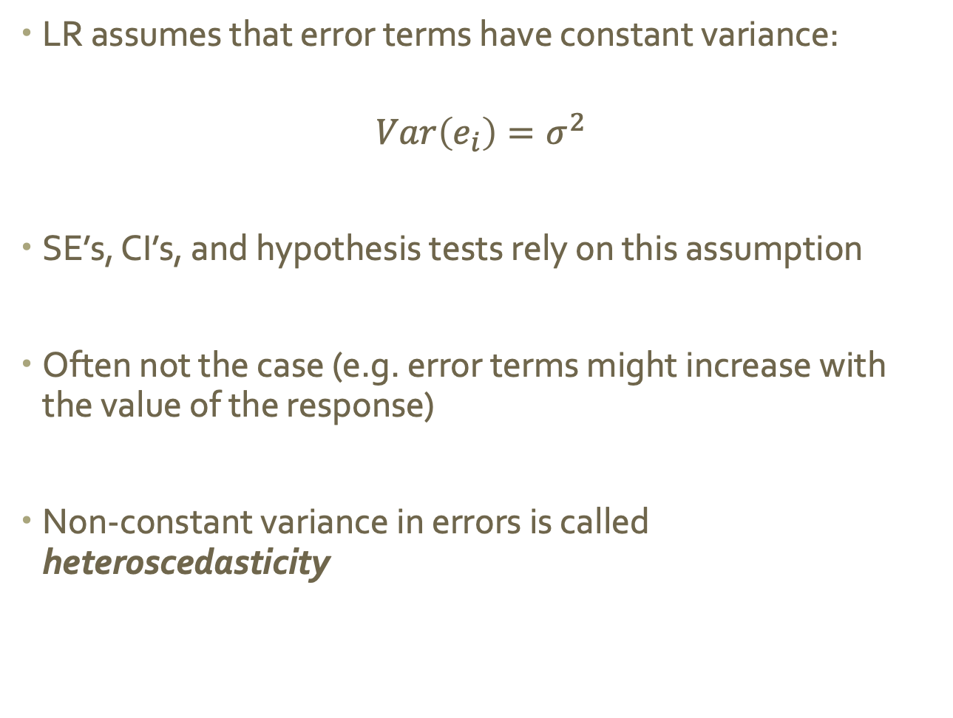
Non-constant variance of error terms
LR assumes that error terms have constant variance:
$$Var\left(e_{i}\right)=σ^{2}$$
SE’s, CI’s, and hypothesis tests rely on this assumption
Often not the case (e.g. error terms might increase with the value of the response)
Non-constant variance in errors is called heteroscedasticity
Notes:
Cis are lower bc SE is lower than it should be
p-values are lower bc

Slide 52
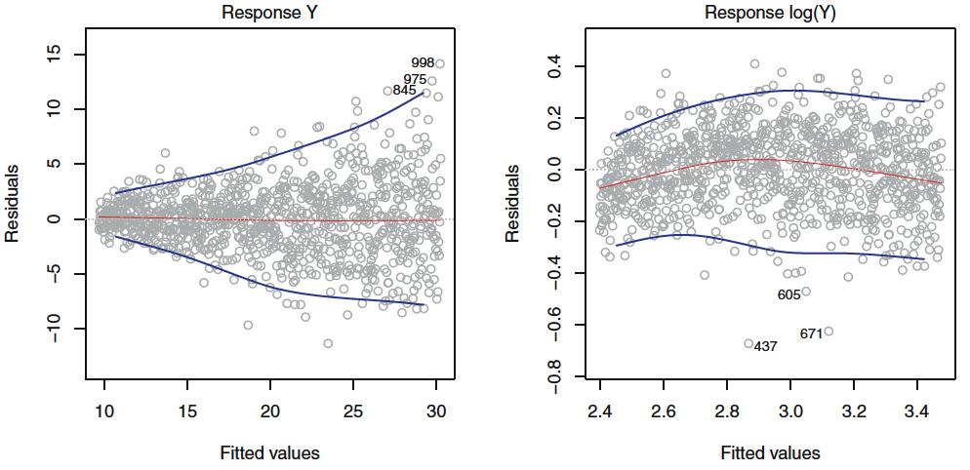
Identify and Fix Heteroscedasticy
Identifying: The residuals plot will show a funnel shape
Fixing:
transform the response using a concave function (like log or sqrt)
weight the observations proportional to the inverse variance
Notes:
Cis are lower bc SE is lower than it should be
p-values are lower bc

Slide 53
Outliers
An outlier is an observation whose true response is REALLY FAR from the one predicted by the model
Sometimes indicate a problem with the model (i.e. a missing predictor), or might just be a data collection error
Can mess with RSE and R², which can lead us to misinterpret the model’s fit
Notes:
Cis are lower bc SE is lower than it should be
p-values are lower bc

Slide 54
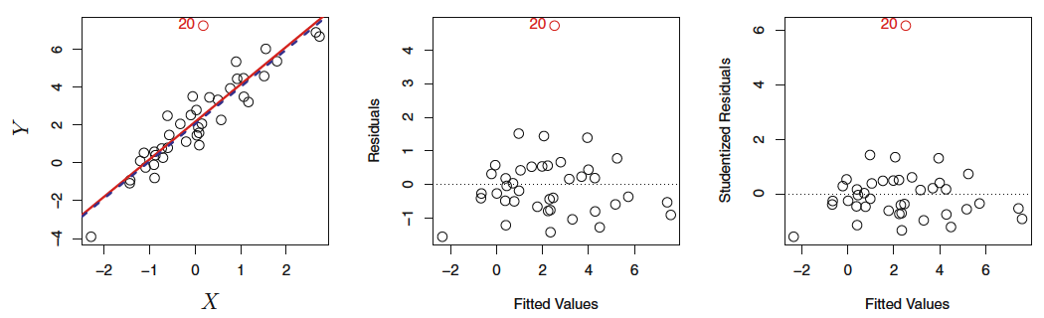
Identify and Fix Outliers
Identify: Residual plots can help identify outliers, but sometimes it’s hard to pick a cutoff point (how far is “too far”?)
Fix:
Divide each residual by dividing by its estimated standard error (studentized residuals), and flag anything larger than 3 in absolute value
Notes:
Studentizing == dud who came up with published under the name student

Slide 55
High Leverage Points
Outliers are unusual values in the response
High leverage points are unusual values in the predictor(s)
The more predictors you have, the harder they can be to spot
These points can have a major impact on the least squares line, which could invalidate the entire fit
We don’t want only one or a few inputs to cause large changes in the entire model
Notes:
Cis are lower bc SE is lower than it should be
p-values are lower bc

Slide 56
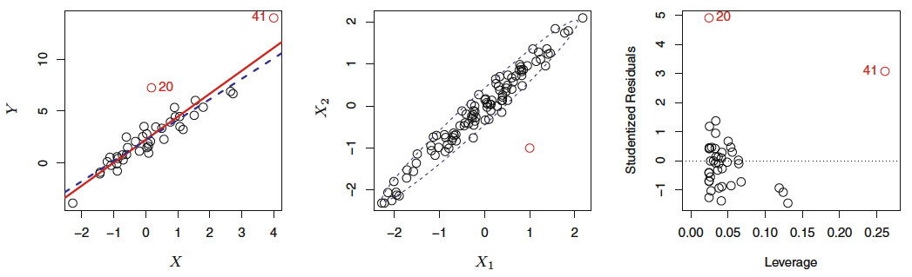
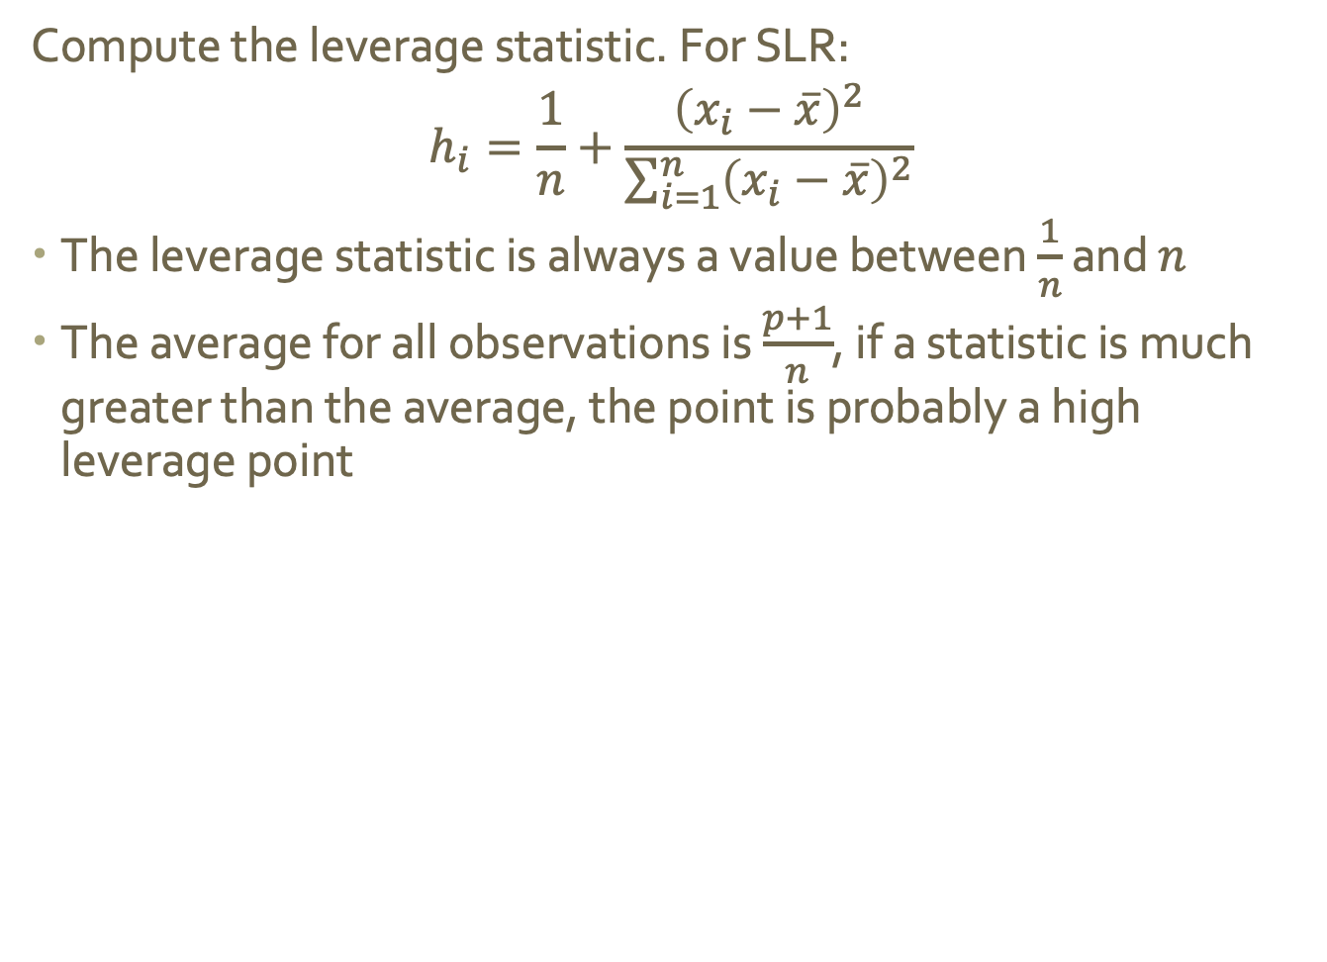
Identify High Leverage Points
Compute the leverage statistic. For SLR:
$$h_{i}=\frac{1}{n}+\frac{{\left(x_{i}−\overline{x}\right)}^{2}}{\sum_{i=1}^{n}{{\left(x_{i}−\overline{x}\right)}^{2}}}$$
The leverage statistic is always a value between $\frac{1}{n}$ and $n$
The average for all observations is $\frac{p+1}{n}$, if a statistic is much greater than the average, the point is probably a high leverage point
Notes:
41 has high leverage, 20 does not

Slide 57
Collinearity
Collinearity is when two or more predictor variables are closely related to one another
This makes it hard to isolate the individual effects of each predictor, which increases uncertainty in coefficient estimates
As a result, it is harder to detect whether or not an effect is actually present (because SE has increased)
Notes:
41 has high leverage, 20 does not

Slide 58
Identify Collinearity
Look at the correlation matrix of the predictors
Auto dataset: just about everything is highly correlated
Note: multicollinearity is when more than two variables are correlated; this will not show in this correlation matrix.
Notes:
41 has high leverage, 20 does not

Slide 59
Dealing with Collinearity
Options include:
Drop one of the problematic variables from the regression (collinearity implies they’re redundant)
Combine collinear variables into a single predictor (ex. take the average)
Notes:
41 has high leverage, 20 does not

